Slide 1
Electronics Systems (938II)
Lecture 2.2
Building Blocks of Electronic Systems – Arithmetic operations

Slide 2
Combinational circuits for arithmetic operations*
Let’s assume arithmetic operations on integers (with sign)
Addition
Subtraction
Multiplication
Division
For this purpose, integers are represented using two’s complement (C2)

Slide 3
Two’s complement representation (of integers with sign)*
Assume N bits
Most significant bit (MSB), the leftmost one, is the sign bit
MSB
LSB
N-1
N-2
N-3
…
1
0
(sign bit)

Slide 4
Two’s complement representation (of integers with sign)*
Positive numbers
Natural binary representation
Sign bit = 0
Example: 1 → 000…01
0
0
0
…
0
1
1 (decimal base)

Slide 5
Two’s complement representation (of integers with sign)*
Negative numbers
Get absolute binary representation (i.e. corresponding positive value)
Invert (or complement) all bits
Add 1 (ignoring overflow)

Slide 6
Two’s complement representation (of integers with sign)*
Negative numbers
Get absolute binary representation (i.e. corresponding positive value)
Invert (or complement) all bits
Add 1 (ignoring overflow)
Example: –1

Slide 7
Two’s complement representation (of integers with sign)*
Negative numbers
Get absolute binary representation (i.e. corresponding positive value)
Invert (or complement) all bits
Add 1 (ignoring overflow)
Example: –1
0
0
0
…
0
1
1 (decimal base)

Slide 8
Two’s complement representation (of integers with sign)*
Negative numbers
Get absolute binary representation (i.e. corresponding positive value)
Invert (or complement) all bits
Add 1 (ignoring overflow)
Example: –1
0
0
0
…
0
1
1 (decimal base)
1
1
1
…
1
0

Slide 9
Two’s complement representation (of integers with sign)*
Negative numbers
Get absolute binary representation (i.e. corresponding positive value)
Invert (or complement) all bits
Add 1 (ignoring overflow)
Example: –1
0
0
0
…
0
1
1 (decimal base)
1
1
1
…
1
0
+
0
0
0
…
0
1
1
1
1
…
1
1
-1 (decimal base)

Slide 10
Two’s complement representation (of integers with sign)*
Negative numbers
Get absolute binary representation (i.e. corresponding positive value)
Invert (or complement) all bits
Add 1 (ignoring overflow)
Example: –2

Slide 11
Two’s complement representation (of integers with sign)*
Negative numbers
Get absolute binary representation (i.e. corresponding positive value)
Invert (or complement) all bits
Add 1 (ignoring overflow)
Example: –2
0
0
0
…
1
0
2 (decimal base)

Slide 12
Two’s complement representation (of integers with sign)*
Negative numbers
Get absolute binary representation (i.e. corresponding positive value)
Invert (or complement) all bits
Add 1 (ignoring overflow)
Example: –2
0
0
0
…
1
0
2 (decimal base)
1
1
1
…
0
1

Slide 13

Two’s complement representation (of integers with sign)*
Negative numbers
Get absolute binary representation (i.e. corresponding positive value)
Invert (or complement) all bits
Add 1 (ignoring overflow)
Example: –2
0
0
0
…
1
0
2 (decimal base)
1
1
1
…
0
1
+
0
0
0
…
0
1
1
1
1
…
1
0
-2 (decimal base)

Slide 14

Two’s complement representation (of integers with sign)*
Range of signed integer numbers (in decimal base) = $[−2^{N−1}÷2^{N−1}−1]$

Slide 15
Two’s complement representation (of integers with sign)*
Range of signed integer numbers (in decimal base) = $[−2^{N−1}÷2^{N−1}−1]$
C2 representation
011…11
…
000…01
000…00
111…11
111…01
…
100…00

Slide 16

Two’s complement representation (of integers with sign)*
Range of signed integer numbers (in decimal base) = $[−2^{N−1}÷2^{N−1}−1]$
Example: $N = 3$
$2^{N−1}−1=2^{2}−1=4−1=3$
$−2^{N−1}=−2^{2}=−4$

Slide 17


Two’s complement representation (of integers with sign)*
Range of signed integer numbers (in decimal base) = $[−2^{N−1}÷2^{N−1}−1]$
Example: $N = 3$
$2^{N−1}−1=2^{2}−1=4−1=3$
$−2^{N−1}=−2^{2}=−4$
C2 representation | Decimal base
011 | 3
010 | 2
001 | 1
000 | 0
111 | -1
110 | -2
101 | -3
100 | -4

Slide 18
Two’s complement representation (of integers with sign)*
Why this?
Because it allows to perform arithmetic operations without particular (or dedicated) resources to handle the sign
Lower costs
Lower delays
Subtraction can be implemented as the addition with the opposite number; for examples …
10 – 18 = 10 + (-18)
12 – (-7) = 12 + 7
…
Let’s see some examples
Assuming N = 3 bits

Slide 19
Two’s complement representation (of integers with sign)*
1 + 1
1 + (-1) → 1 – 1
1 + (-2) → 1 – 2
(1)
0
0
1
+
(1)
0
0
1
+
(1)
0
0
1
+
(1)
0
0
1
(-1)
1
1
1
(-2)
1
1
0
(2)
0
1
0
(0)
0
0
0
(-1)
1
1
1
-1 + (-1) → -1 – 1
-2 + (-2) → -2 – 2
-2 + 3 → 3 – 2
(-1)
1
1
1
+
(-2)
1
1
0
+
(-2)
1
1
0
+
(-1)
1
1
1
(-2)
1
1
0
(3)
0
1
1
(-2)
1
1
0
(-4)
1
0
0
(1)
0
0
1

Slide 20
Adder*
The sum of 2 N-bit numbers requires N+1 bits to be represented
N = 1 → 2 bits to represent the sum
The simplest adder is the Half Adder (HA)
Just the sum of the two 1-bit inputs (a, b)
Output must be 2-bit

Slide 21
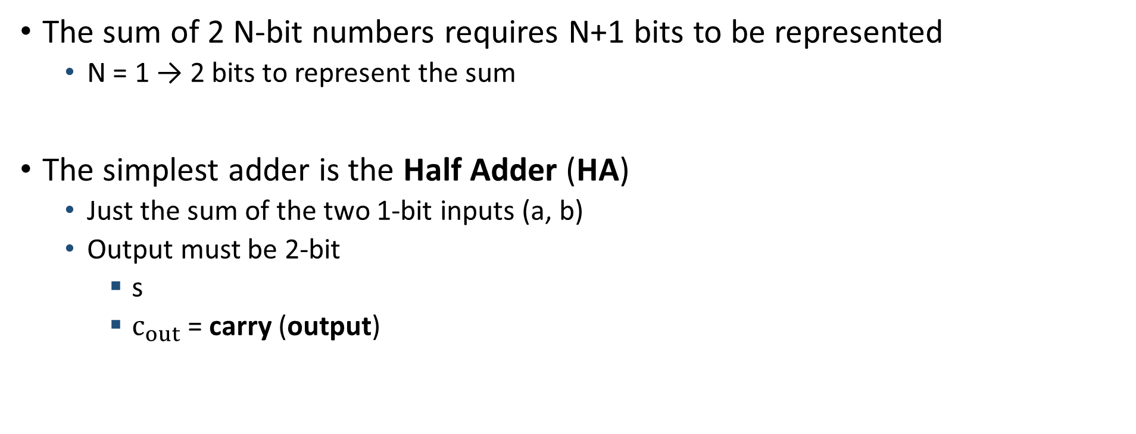
Adder*
The sum of 2 N-bit numbers requires N+1 bits to be represented
N = 1 → 2 bits to represent the sum
The simplest adder is the Half Adder (HA)
Just the sum of the two 1-bit inputs (a, b)
Output must be 2-bit
s
$c_{out}$ = carry (output)

Slide 22
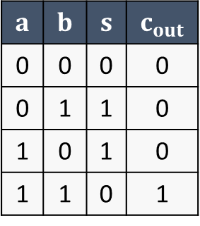
Half Adder (HA)*
HA truth table
$$a$$ | $$b$$ | $$s$$ | $$c_{out}$$
0 | 0 | 0 | 0
0 | 1 | 1 | 0
1 | 0 | 1 | 0
1 | 1 | 0 | 1

Slide 23
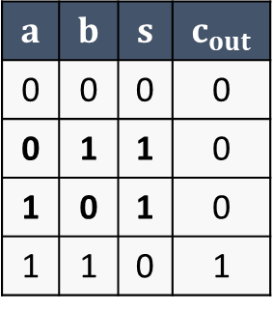


Half Adder (HA)*
HA truth table
$$a$$ | $$b$$ | $$s$$ | $$c_{out}$$
0 | 0 | 0 | 0
0 | 1 | 1 | 0
1 | 0 | 1 | 0
1 | 1 | 0 | 1
$s = 1$, when $a≠b$

Slide 24

Half Adder (HA)*
HA truth table
$$a$$ | $$b$$ | $$s$$ | $$c_{out}$$
0 | 0 | 0 | 0
0 | 1 | 1 | 0
1 | 0 | 1 | 0
1 | 1 | 0 | 1
$s = 1$, when $a≠b$

Slide 25

Half Adder (HA)*
HA truth table
$$a$$ | $$b$$ | $$s$$ | $$c_{out}$$
0 | 0 | 0 | 0
0 | 1 | 1 | 0
1 | 0 | 1 | 0
1 | 1 | 0 | 1
$s = 1$, when $a≠b$
$$s=a⊕b$$

Slide 26
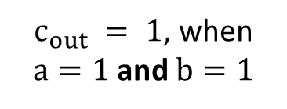
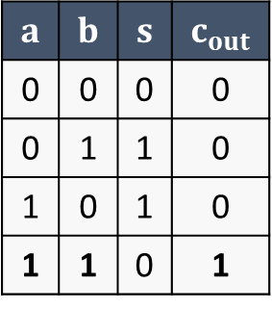

Half Adder (HA)*
HA truth table
$$a$$ | $$b$$ | $$s$$ | $$c_{out}$$
0 | 0 | 0 | 0
0 | 1 | 1 | 0
1 | 0 | 1 | 0
1 | 1 | 0 | 1
$s = 1$, when $a≠b$
$$s=a⊕b$$
$c_{out} = 1$, when
$a=1$ and $b=1$

Slide 27

Half Adder (HA)*
HA truth table
$$a$$ | $$b$$ | $$s$$ | $$c_{out}$$
0 | 0 | 0 | 0
0 | 1 | 1 | 0
1 | 0 | 1 | 0
1 | 1 | 0 | 1
$s = 1$, when $a≠b$
$$s=a⊕b$$
$c_{out} = 1$, when
$a=1$ and $b=1$
$$c_{out}=a∙b$$

Slide 28
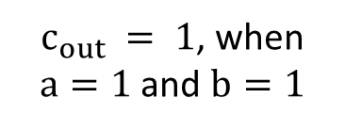
Half Adder (HA)*
HA truth table
$$a$$ | $$b$$ | $$s$$ | $$c_{out}$$
0 | 0 | 0 | 0
0 | 1 | 1 | 0
1 | 0 | 1 | 0
1 | 1 | 0 | 1
$s = 1$, when $a≠b$
$$s=a⊕b$$
$c_{out} = 1$, when
$a=1$ and $b=1$
$$c_{out}=a∙b$$

Slide 29
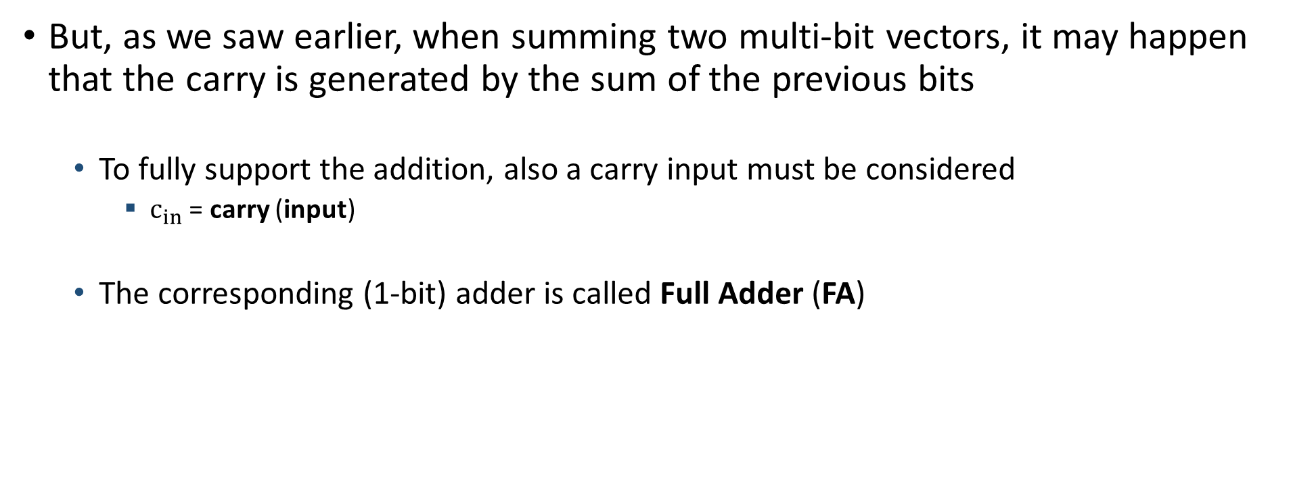
Adder*
But, as we saw earlier, when summing two multi-bit vectors, it may happen that the carry is generated by the sum of the previous bits
To fully support the addition, also a carry input must be considered
$c_{in}$ = carry (input)
The corresponding (1-bit) adder is called Full Adder (FA)

Slide 30

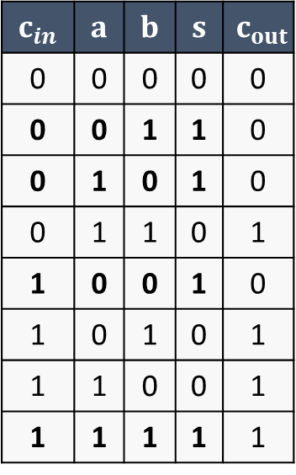

Full Adder (FA)*
FA truth table
$$c_{in}$$ | $$a$$ | $$b$$ | $$s$$ | $$c_{out}$$
0 | 0 | 0 | 0 | 0
0 | 0 | 1 | 1 | 0
0 | 1 | 0 | 1 | 0
0 | 1 | 1 | 0 | 1
1 | 0 | 0 | 1 | 0
1 | 0 | 1 | 0 | 1
1 | 1 | 0 | 0 | 1
1 | 1 | 1 | 1 | 1
$$s=a⊕b⊕c_{in}$$

Slide 31

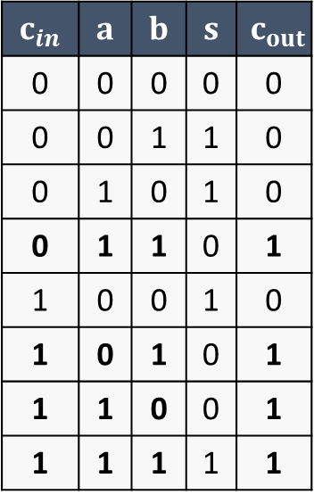

Full Adder (FA)*
FA truth table
$$c_{in}$$ | $$a$$ | $$b$$ | $$s$$ | $$c_{out}$$
0 | 0 | 0 | 0 | 0
0 | 0 | 1 | 1 | 0
0 | 1 | 0 | 1 | 0
0 | 1 | 1 | 0 | 1
1 | 0 | 0 | 1 | 0
1 | 0 | 1 | 0 | 1
1 | 1 | 0 | 0 | 1
1 | 1 | 1 | 1 | 1
$$s=a⊕b⊕c_{in}$$
$c_{out}=\left(a∙b\right)+$ $\left(a∙c_{in}\right)+$ $\left(b∙c_{in}\right)$

Slide 32


Full Adder (FA)*
$$s=a⊕b⊕c_{in}$$
$c_{out}=\left(a∙b\right)+$ $\left(a∙c_{in}\right)+$ $\left(b∙c_{in}\right)$

Slide 33




Adder (for multi-bit operands)*
A generic adder (for N-bit operands) can be built by cascading N FAs
Example: 4-bit adders
Inputs
a = {a₃ a₂ a₁ a₀}
b = {b₃ b₂ b₁ b₀}
c_{in}
Outputs
s = {s₃ s₂ s₁ s₀}
c_{out}

Slide 34
Adder (for multi-bit operands)*
The one saw before is called also Ripple Carry Adder (RCA)
The carry path propagate from the input to the output
Path is proportional to the bit width of the input operands
The delay path may be very high
Other solutions (and architectures/circuits) for adders exist to solve this problem
Carry Save Adder (CSA)
Carry Bypass Adder (CBA), or Carry Skip Adder
Carry Lookahead Adder (CLA)

Slide 35
Adder (for multi-bit operands)*
CSA, CBA, CLA, …: just for the sake of completeness
We are not going to analyze them
However, remember that each solution is a trade-off
They can be advantageous in terms of delay with respect to the RCA
But they can also present costs in other terms (e.g., resources)

Slide 36
Subtractor (for multi-bit operands)*
If you remember the properties of two’s complement representation…
A – B = A + (-B)

Slide 37
Adder/Subtractor (for multi-bit operands)*
For a full-case solution, i.e. adder/subtractor
Inputs : A, B
Control : sub
If sub = 0 → A + B
If sub = 1 → A – B = A + (-B)

Slide 38

Adder/Subtractor (for multi-bit operands)*
For a full-case solution, i.e. adder/subtractor
If you remember, to get -B from B:
Complement all bits of B
Add 1
This can be done by exploiting the $c_{in}$ input of RCA

Slide 39
Adder/Subtractor (for multi-bit operands)*
For a full-case solution, i.e. adder/subtractor
If you remember, to get -B from B:
Complement all bits of B
Add 1
This can be done by exploiting the $c_{in}$ input of RCA

Slide 40
Multiplier*
The multiplication of a N-bit number by an M-bit number requires N+M bits to be represented
Typically, N = M → 2N bits to represent the product
The simplest way: shift-and-add algorithm
Similar to the paper-and-pencil method for decimal multiplication

Slide 41




























Multiplier*
Assume N = 4 and calculate p = a * b
a = {a₃ a₂ a₁ a₀}
b = {b₃ b₂ b₁ b₀}
p
$$b_{0}∙a_{3}$$
$$b_{0}∙a_{2}$$
$$b_{0}∙a_{1}$$
$$b_{0}∙a_{0}$$
$$+$$
$$b_{1}∙a_{3}$$
$$b_{1}∙a_{2}$$
$$b_{1}∙a_{1}$$
$$b_{1}∙a_{0}$$
$$+$$
$$b_{2}∙a_{3}$$
$$b_{2}∙a_{2}$$
$$b_{2}∙a_{1}$$
$$b_{2}∙a_{0}$$
$$+$$
$$b_{3}∙a_{3}$$
$$b_{3}∙a_{2}$$
$$b_{3}∙a_{1}$$
$$b_{3}∙a_{0}$$
$$=$$
$$p_{7}$$
$$p_{6}$$
$$p_{5}$$
$$p_{4}$$
$$p_{3}$$
$$p_{2}$$
$$p_{1}$$
$$p_{0}$$

Slide 42
Multiplier*
Assume N = 4 and calculate p = a * b
a = {a₃ a₂ a₁ a₀}
b = {b₃ b₂ b₁ b₀}
p
$$b_{0}∙a_{3}$$
$$b_{0}∙a_{2}$$
$$b_{0}∙a_{1}$$
$$b_{0}∙a_{0}$$
$$+$$
$$b_{1}∙a_{3}$$
$$b_{1}∙a_{2}$$
$$b_{1}∙a_{1}$$
$$b_{1}∙a_{0}$$
$$+$$
$$b_{2}∙a_{3}$$
$$b_{2}∙a_{2}$$
$$b_{2}∙a_{1}$$
$$b_{2}∙a_{0}$$
$$+$$
$$b_{3}∙a_{3}$$
$$b_{3}∙a_{2}$$
$$b_{3}∙a_{1}$$
$$b_{3}∙a_{0}$$
$$=$$
$$p_{7}$$
$$p_{6}$$
$$p_{5}$$
$$p_{4}$$
$$p_{3}$$
$$p_{2}$$
$$p_{1}$$
$$p_{0}$$

Slide 43
Multiplier*
Assume N = 4 and calculate p = a * b
a = {a₃ a₂ a₁ a₀}
b = {b₃ b₂ b₁ b₀}
p
N – 1 additions of numbers with a bit width of 2N – 1 Sequential multiplier
0
0
0
$$b_{0}∙a_{3}$$
$$b_{0}∙a_{2}$$
$$b_{0}∙a_{1}$$
$$b_{0}∙a_{0}$$
$$+$$
0
0
$$b_{1}∙a_{3}$$
$$b_{1}∙a_{2}$$
$$b_{1}∙a_{1}$$
$$b_{1}∙a_{0}$$
0
$$+$$
0
$$b_{2}∙a_{3}$$
$$b_{2}∙a_{2}$$
$$b_{2}∙a_{1}$$
$$b_{2}∙a_{0}$$
0
0
$$+$$
$$b_{3}∙a_{3}$$
$$b_{3}∙a_{2}$$
$$b_{3}∙a_{1}$$
$$b_{3}∙a_{0}$$
0
0
0
$$=$$
$$p_{7}$$
$$p_{6}$$
$$p_{5}$$
$$p_{4}$$
$$p_{3}$$
$$p_{2}$$
$$p_{1}$$
$$p_{0}$$

Slide 44
Sequential multiplier*
Logic for calculation of AND products
One adder
The RCA we saw before
A register to store partial products
Requiring N – 1 steps/cycles to perform the multiplication

Slide 45
Combinational multiplier
Example: N = 4

Slide 46






Combinational multiplier
Example: N = 4
3x 4-bit RCAs
In general
N – 1x RCAs
Each of N bits
Plus logic for AND!!!

Slide 47
Divisor*
Similarly to multiplier, the divisor can be implemented exploiting again an adder (RCA) supporting two’s complement addition
Division can be split in a sequence of subtractions and comparison
Example: 63 / 12
Quotient = 0
63 – 12 = 51 → Quotient += 1 (1), 51 > 12 ? Yes
51 – 12 = 39 → Quotient += 1 (2), 39 > 12 ? Yes
39 – 12 = 27 → Quotient += 1 (3), 13 > 12 ? Yes
27 – 12 = 15 → Quotient += 1 (4), 15 > 12 ? Yes
15 – 12 = 3 → Quotient += 1 (5), 3 > 12 ? No → Reminder = 3
Or other combinational circuits can be implemented

Slide 48
Multiplicator/Divisor*
We are not going to see the circuit of a combinational divisor, however …
… remember that multipliers and divisors are expansive
Resources and/or time (steps/cycles)

Slide 49
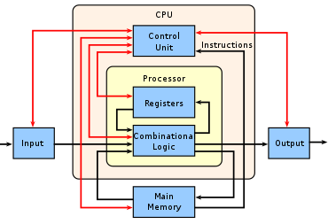
Combinational logic in modern processors*
If you remember the overall outline of a modern processor

Slide 50
Combinational logic in modern processors*
The main component of the Combinational logic block is called ALU
ALU = Arithmetic Logic Unit

Slide 51
ALU*
Main operations (but not all) supported by an ALU
OPCODE (select) |  | Meaning
ADD | 00001 | A + B
SUB | 00010 | A – B
MULT | 01000 | A * B
NOT | 10000 | Complement A
AND | 10001 | Bit-wise AND
OR | 10010 | Bit-wise OR
XOR | 10011 | Bit-wise XOR
EQL | 01011 | Check A == B
… | … | …

Slide 52
ALU*
Therefore, a possible architecture for an ALU can be the following one

Slide 53




ALU*
Therefore, a possible architecture for an ALU can be the following one
Basic logic gates

Slide 54


ALU*
Therefore, a possible architecture for an ALU can be the following one
Basic logic gates
Multiplexers

Slide 55


ALU*
Therefore, a possible architecture for an ALU can be the following one
Basic logic gates
Multiplexers
XOR/Comparator

Slide 56


ALU*
Therefore, a possible architecture for an ALU can be the following one
Basic logic gates
Multiplexers
XOR/Comparator
Adder/Subtractor

Slide 57
Exercise with SystemVerilog
Implementation of a 4-bit Adder and simulation with Modelsim

Slide 58
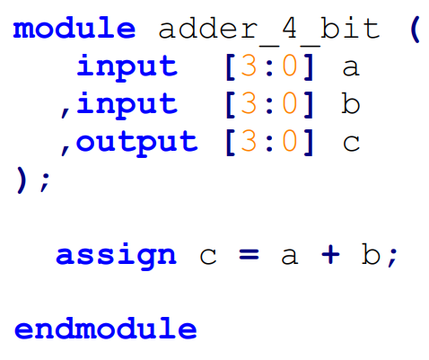



Exercise with SystemVerilog
Implementation of a 4-bit Adder and simulation with Modelsim

Slide 59


Exercise with SystemVerilog
Implementation of a 4-bit Adder and simulation with Modelsim

Slide 60


Exercise with SystemVerilog
Implementation of a 4-bit Adder and simulation with Modelsim
Continuous assignment (again)
assign <signal> = <expression>;
But using arithmetic operator (+) in <expression>

Slide 61

Exercise with SystemVerilog
Implementation of a 4-bit Adder and simulation with Modelsim
Some operators in SV
Arithmetic
They can be use in any expression/assignment (also blocking or non-blocking)
Addition +
Subtraction –
Multiplication *
Division /
Power ** (e.g., a**b = $a^{b}$)
Mod % (e.g., a % b = a mod b)

Slide 62
Exercise with SystemVerilog
Implementation of a 4-bit Adder and simulation with Modelsim
Some operators in SV
Bit-wise
They can be use in any expression/assignment (also blocking or non-blocking)
AND &
OR |
NOT ~

Slide 63
Exercise with SystemVerilog
Implementation of a 4-bit Adder and simulation with Modelsim
Some operators in SV
Logical
They can be used in any control condition (if–else, ternary operator)
AND &&
OR ||
NOT !

Slide 64
Exercise with SystemVerilog
Implementation of a 4-bit Adder and simulation with Modelsim
Some operators in SV
Relational
They can be used in any control condition (if–else, ternary operator)
Equality ==
Inequality !=
Greater than >
Greater than or equal >=
Lower than <
Lower than or equal <=

Slide 65
Exercise with SystemVerilog
Implementation of a 4-bit Adder and simulation with Modelsim
Try to simulate it on Modelsim with the force and run command
To assign a multi-bit value with the force command use the syntax for constants in SV
force a 4’d0
force b 4’d3
…

Slide 66
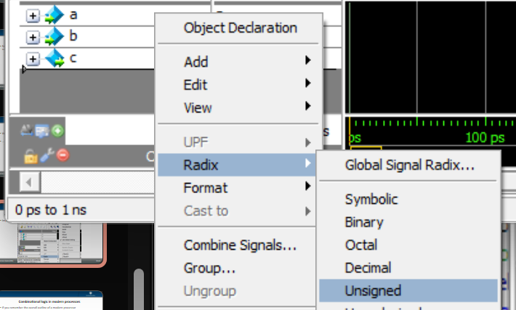
Exercise with SystemVerilog
Implementation of a 4-bit Adder and simulation with Modelsim
Try to simulate it on Modelsim with the force and run command
A suggestion: to plot the waveform, use the Unsigned radix (for a, b, and c)

Slide 67
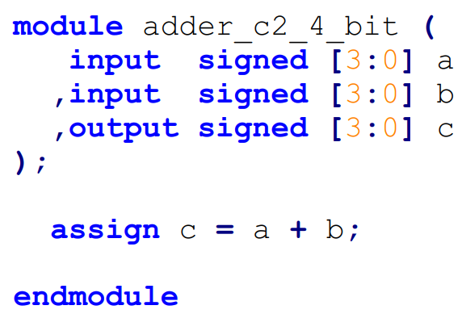


Exercise with SystemVerilog
Implementation of a 4-bit Adder and simulation with Modelsim
Signed version: supporting two’s complement operands
Signals must be declared as signed
By default, all signals are unsigned

Slide 68
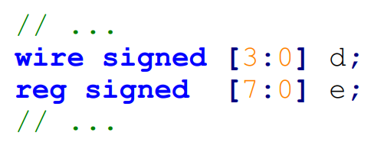
Exercise with SystemVerilog
Implementation of a 4-bit Adder and simulation with Modelsim
Signed version: supporting two’s complement operands
Signals must be declared as signed
By default, all signals are unsigned
It applies to both ports and internal signals

Slide 69
Exercise with SystemVerilog
Implementation of a 4-bit Adder and simulation with Modelsim
Signed version: supporting two’s complement operands
Signals must be declared as signed
By default, all signals are unsigned
It applies to both ports and internal signals
It must be specified after the type

Slide 70
Exercise with SystemVerilog
Implementation of a 4-bit Adder and simulation with Modelsim
Signed version: supporting two’s complement operands
Try to simulate it on Modelsim with the force and run command
To assign negative value with the force command use …
force a –4’d1
force b –4’d3
…
Remember of representable range!!!

Slide 71
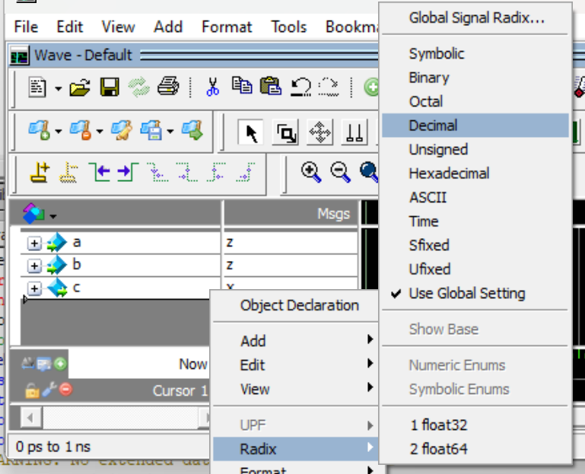
Exercise with SystemVerilog
Implementation of a 4-bit Adder and simulation with Modelsim
Signed version: supporting two’s complement operands
Try to simulate it on Modelsim with the force and run command
A suggestion: to plot the waveform, use the Decimal radix (for a, b, and c)

Slide 72
Exercise with SystemVerilog
Implementation of a 4-bit Adder and simulation with Modelsim
You can find all the files about this exercise in the dedicated folder on the Team of the course
File > Electronics Systems module > Crocetti > Exercises > 2.2
Try to simulate on your own both unsigned and signed version of the 4-bit adder
Unsigned version → ‘adder_4_bit’
Signed version → ‘adder_c2_4_bit’

Slide 73

Exercise with SystemVerilog
Implementation of a 4-bit Adder and simulation with Modelsim
For the signed version, you can find ‘adder_c2_4_bit’ two auxiliary .do files
‘wave_adder_c2.do’
‘sim_adder_c2.do’
Refer to README.txt file
However, you can run them using again the Transcript Tab and the do command
After having launched the simulation
wave_adder_c2.do
sim_adder_c2.do

